Slide 1
K.R. MANGALAM UNIVERSITY
Mini Project — Mid Term Evaluation
THRYLOS
Employee Management Portal
Problem Statement: (Industry-Based) Employee Management System for Modern Organizations
🔄 STAGE 2–3 IN PROGRESS
Ishan Jha- 2401010022 (Team Leader)
Rashmi Jha — 2401010166
Utsav Ratan — 2401010046
Vivek Rai — 2401010303
Prem Kumar — 2401010243
Vicky Jha — 2401010248

Slide 2
0◆
What We're Building
10 Core Modules — Full-Stack Employee Management Ecosystem
Login & Authentication
Payment Gateway & Verification
01
06
Overview Stats Dashboard
Bulk Upload & Import
02
07
Attendance Tracker
Notification Center
03
08
Real-Time Team Chat
File & Media Manager
04
09
Analytics Dashboard
Leave Management
05
10

Slide 3
01
Login & Authentication
THRYLOS
🛡️ Role-Based Access
Super Admin, Admin & Employee with granular permissions
A
Location access required
🔑 Supabase Auth
📍
Location permission is mandatory for security.
Without it, you can't login.
Secure JWT sessions, email/password authentication
⟳ Requesting...
📍 Location Gating
Mandatory geo-verification for security compliance
If location is blocked, enable it in your browser settings then refresh.
Role-Based Login Modes:
📱 OTP Verification
Super Admin
Admin
Employee
Two-factor authentication layer for critical ops

Slide 4
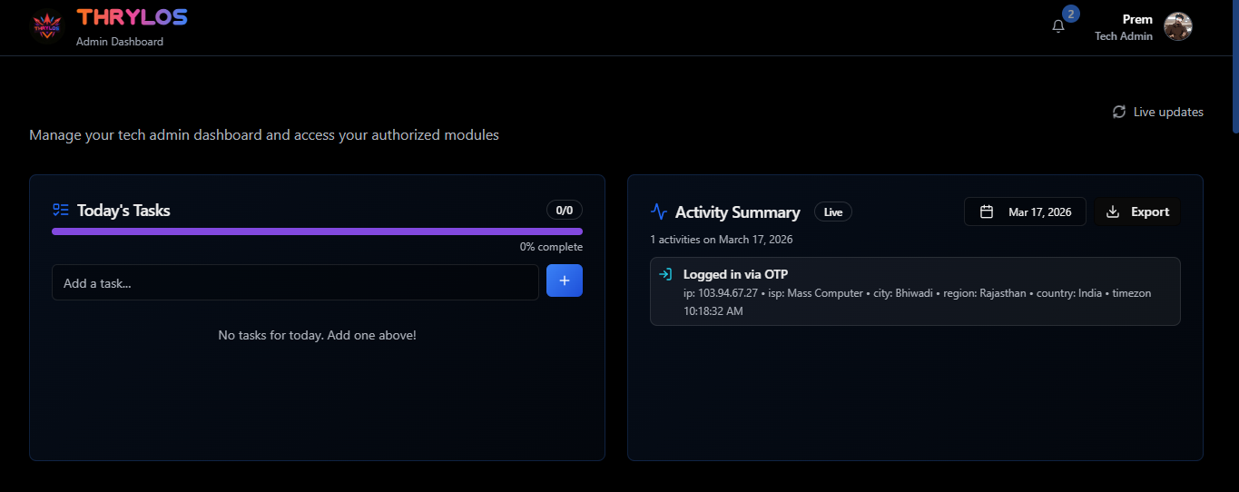
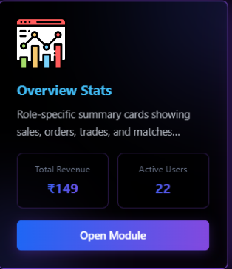
02
Overview Stats Dashboard
Total Revenue
Pending Orders
Transactions
Monthly Growth
₹14,000
02
04
18.7%
+12.4%
-3 today
+89/week
vs last mo
Revenue & Orders — Last 6 Months
85K
71K
63K
52K
45K
38K
Oct
Nov
Dec
Jan
Feb
Mar

Slide 5
03
Attendance Tracker
05
01
1
83%
Present Today
Absent
Late
Rate
March 2026
Today's Attendance Log
S
M
T
W
T
F
S
Employee
Role
Check In
Status
1
Ishan Jha
Team Lead
09:02 AM
Present
2
3
4
5
6
7
8
Utsav Ratan
Developer
09:15 AM
Present
9
10
11
12
13
14
15
Prem Kumar
Developer
10:34 AM
Late
16
17
18
19
20
21
22
Rashmi Jha
Designer
09:05 AM
Present
23
24
25
26
27
28
29
Vivek Rai
Developer
—
Absent
30
31
Vicky Jha
Developer
09:20 AM
Present

Slide 6
04
Real-Time Team Chat
CHANNELS
# dev-team • 6 members online
⚡ Real-Time Messaging
# general
Ishan:
Supabase Realtime subscriptions for instant delivery
# dev-team
Pushed the attendance module fix 🚀
10:24
Utsav:
# design
Nice! PR is up for review
📁 File Sharing
10:26
# alerts
On it, checking now 👀
Share documents, images and media in channels
10:28
# random
Prem:
Analytics dashboard ready for testing
🔔 Push Notifications
10:31
Great work team! Let's merge after QA
Mention alerts, DMs and keyword triggers
10:33
👥 Channel Management
Team, project, or dept-organized channels
Type a message... 📎 😊 ▶

Slide 7
05
Analytics Dashboard
Revenue Trend — Multi-Source Analysis
Revenue Mix
₹2.8L
39% Payments
17% Esports
Oct
Nov
Dec
Jan
Feb
Mar
44% Social
Employee Performance
Task Completion
System Uptime
84/100
91%
99.7%
Avg team score
Weekly target
Last 30 days

Slide 8
06
Payment Gateway & Verification
Payment Verification Flow
💳
📸
👁️
✔️
🔔
Payment
Submitted
▶
Screenshot
Uploaded
▶
Admin
Review
▶
Amount
Verified
▶
Status
Updated
Recent Payment Verifications
🖼️ Screenshot Proof
Customer
Amount
Method
Status
Date
Upload payment screenshots for verification
Arjun Mehta
₹4,500
UPI
Verified
Mar 15
🔍 Multi-Source Sync
Priya Singh
₹2,200
NEFT
Pending
Mar 15
UPI, NEFT, Card — single dashboard
Rohit Kumar
₹7,800
UPI
Verified
Mar 14
⚡ Instant Status Update
Real-time push on approval/rejection
Sneha Joshi
₹1,500
Card
Rejected
Mar 14
Amit Sharma
₹9,200
NEFT
Verified
Mar 13
📊 Revenue Tracking
Auto-aggregates verified payments

Slide 9
07
Bulk Upload & Import
📤
📊 CSV & Excel Import
Native .csv/.xlsx with auto column mapping
Drag & Drop CSV / Excel files here
or click to browse | Supports: .csv, .xlsx, .json
🔍 Validation Engine
⬆ Upload
📋 Template
📥 Export
Detects duplicates, missing fields, format errors
Import Preview — employees_march.csv (142 records)
⚡ Batch Processing
Process 1000+ records with progress tracking
76% Complete — 108/142 processed | 2 errors
Name
Email
Role
Dept
Status
Ananya Das
ananya@t.in
Admin
Tech
✅ OK
📥 Export Reports
Ravi Patel
ravi@t.in
Emp.
HR
✅ OK
Download filtered data as CSV anytime
Meera Shah
meera@t.in
Lead
Sales
⚠ Dup.

Slide 10
08
Notification Center
🔔 Notification Center
7
📡 Real-Time Push
All (7)
Unread (4)
Alerts (2)
System (1)
Instant browser & in-app via Supabase channels
💳
Payment Verified
Arjun Mehta's ₹4,500 payment confirmed
2 min ago
🎯 Smart Filtering
🏖️
Leave Request
15 min ago
Filter by type, priority, read/unread, date
Vivek Rai applied for 2 days leave
⬆️
Bulk Import Done
108/142 employees imported successfully
1 hr ago
🏷️ Category Tags
⚠️
Attendance Alert
Payment, HR, System, Chat — auto-categorized
3 employees not checked in as of 10:30 AM
2 hr ago
💬
New Chat Message
Ishan Jha mentioned you in #dev-team
3 hr ago
🔕 Do Not Disturb
📁
File Uploaded
Schedule quiet hours with custom preferences
Q1_report.pdf added to Shared Media
5 hr ago

Slide 11
09
File & Media Manager
📁 /Shared Media / Q1-Reports
⬆ Upload
📁 New Folder
Storage Overview
📄
🖼️
📊
🎬
Docs
Images
Video
Other
Q1_Report.pdf
team_photo.jpg
salary_slip.xlsx
onboarding.mp4
2.4 MB
1.1 MB
340 KB
18 MB
18.4 GB used of 50 GB
🔗 Shareable Links
🎨
🗜️
📝
📁
Secure share links with expiry control
🔒 Permission Control
design.figma
contracts.zip
meeting_notes.docx
logo_assets
Role-based access to folders & files
5.2 MB
12 MB
220 KB
47 files
🔍 Full-Text Search
Search by name, tag or file content
📎 Inline Preview
View PDFs, images, videos in-browser

Slide 12
10
Leave Management
Casual Leave
Sick Leave
Earned Leave
Comp-Off
9
7
15
4
available
available
available
available
3/12 used
1/8 used
5/20 used
0/4 used
Apply for Leave
Team Leave Requests
Leave Type
Employee
Type
Dates
Status
Casual Leave ▼
Vivek Rai
Casual
Mar 20-21
Pending
Category
Full Day ▼
Prem Kumar
Sick
Mar 18
Approved
Start Date
📅 Mar 20, 2026
Rashmi Jha
Earned
Mar 25-27
Approved
End Date
Utsav Ratan
Comp-Off
Apr 1
Pending
📅 Mar 21, 2026
Subject
Vicky Jha
Casual
Mar 14
Rejected
Personal emergency
Ishan Jha
Earned
Apr 10-12
Pending
Submit Request

Slide 13
0◆
Technology Stack & Project Progress
Tech Stack
Project Stage Tracker
Frontend:
React + TypeScript + Tailwind CSS
Stage 1 ✅
Backend:
Supabase (PostgreSQL + Auth + Storage)
Core Architecture & Auth
100%
State Mgmt:
React Context API + React Query
Stage 2 🔄
Feature Modules Development
UI Library:
shadcn/ui + Radix UI + Lucide Icons
68%
Charts:
Recharts + Custom Chart.js components
Stage 3 🔄
Integration & Testing
Real-Time:
Supabase Realtime Subscriptions
25%
Stage 4
Build Tool:
Vite + ESLint + TypeScript Compiler
Deployment & Documentation
0%
Module Completion Status
Auth
Overview
Attend.
Chat
Analytics
Payments
Import
Notifs
Files
Leave
100%
90%
85%
75%
70%
65%
60%
55%
50%
80%

Slide 14

THANK YOU
Thrylos Employee Management Portal
K.R. Mangalam University | Mini Project Mid Term Evaluation
Ishan Jha — 2401010022 (Team Leader)
Utsav Ratan — 2401010046 | Prem Kumar — 2401010243
Rashmi Jha — 2401010166 | Vivek Rai — 2401010303 | Vicky Jha — 2401010248
🔄 Stage 2-3 In Progress 🚀

